Slide 1

What is .NET?
Claudia Regio

Slide 2
What is .NET?
.NET is a free, open-source, & cross-platform development platform
Free == FREE
Open-source == We develop in the open!
Cross-platform == Works & runs on Linux, macOS, and Windows
Development platform == programming languages & libraries

Slide 3
What languages can I use? What tools support them?
Languages
C#
F# and more
Tools
Visual Studio
Visual Studio Code

Slide 4
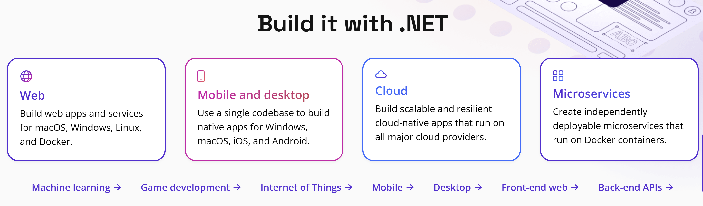
What can I build with .NET?
Almost anything!

Slide 5
Wait…what’s the difference between .NET and .NET Framework?
.NET | .NET Framework
Runs on Linux, macOS, & Windows | Only runs on Windows
Open-source & accepts contributions from community | Source code available but does not accept contributions
All the innovation happens here! Supports more application types and delivers higher performance | Security & reliability bug fixes only
Not shipped with operating system | Included in Windows & updated by Windows updates
Recommended for new development
.NET (V. 5+) | .NET Framework (V. <= 4.8.1)
Runs on Linux, macOS, & Windows | Only runs on Windows
Open-source & accepts contributions from community | Source code available but does not accept contributions
All the innovation happens here! Supports more application types and delivers higher performance | Security & reliability bug fixes only
Not shipped with operating system | Included in Windows & updated by Windows updates
Recommended for new development

Slide 6
Where can I learn more?
.NET Website: https://aka.ms/dotnet/website
.NET Documentation: https://aka.ms/dotnet/documentation
Download .NET: https://aka.ms/dotntevideos/download
.NET Hello World Tutorial: https://aka.ms/dotnethelloworld

